Slide 1
Ensemble learning

Slide 2
What is Ensemble Learning
The general meaning of “ensemble” is “a group of items viewed as a whole rather than individually”.
The meaning is the same in Machine Learning(ML) also.
Ensemble learning is a part of ML which uses multiple learning algorithms to obtain better predictive performance than could be obtained from any of the basic or essential learning algorithms alone.

Slide 3
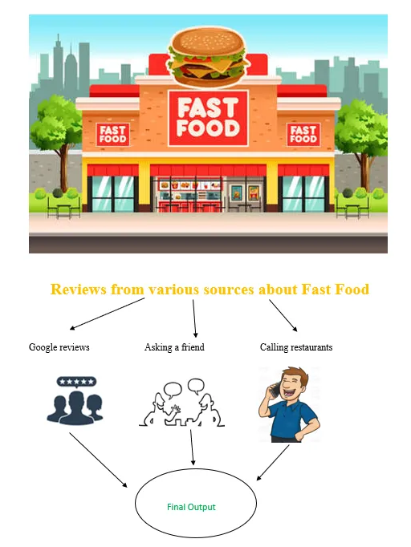
Let’s understand ensemble learning with an example
Ensemble models also work in the same way.
They combine the decisions from multiple models to improve the performance.
Ensemble learning is a machine learning technique that combines multiple models to create a more accurate and robust model than any of the individual models could be on its own. This is done by training multiple models on the same data and then combining their predictions to make a final prediction.

Slide 4
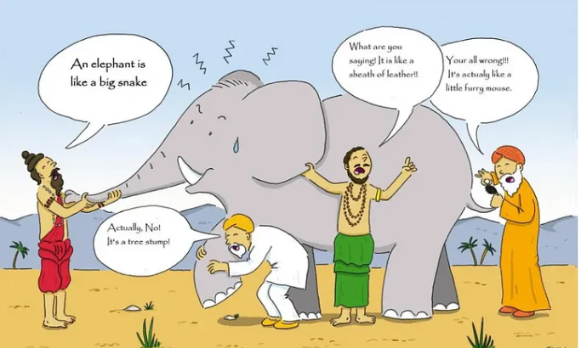
The fundamental principle of the ensemble model is that a group of weak learners come together to form a strong learner, which increases the accuracy of the model.
When we try to predict the target variable by any machine learning technique, the main causes of the difference between the actual and predicted values are noise, variance and bias.
The set reduces these factors (except noise, which is an irreducible error).
Imaging that Fable of blind men and elephant. All of the blind men had their own description of the elephant. Even though each of the description was true, it would have been better to come together and discuss their understanding before coming to final conclusion. This story perfectly describes the Ensemble learning method.

Slide 5
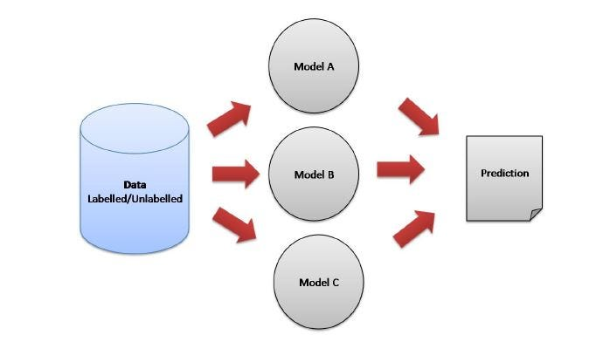
Ensemble model representation

Slide 6
Why do we need Ensemble Models
To understand this we should know bias variance tradeoff
The bias error is an error from erroneous assumptions in the learning algorithm. High bias can cause an algorithm to miss the relevant relations between features and target outputs (underfitting).
The variance is an error from sensitivity to small fluctuations in the training set. A high variance may result from an algorithm modeling the random noise in the training data (overfitting).
The bias-variance trade-off is a core problem in supervised learning. Preferably, we want to select a model that accurately captures the regularities(the quality of being characterized by a fixed rate) in its training data and generalizes well to unseen data. It is typically not possible to do both simultaneously. Hence, we have to maintain an optimal balance in bias and variance.

Slide 7
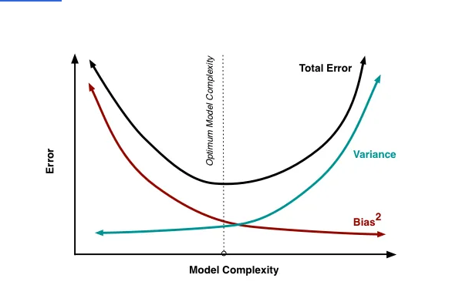
This image is a visualization of the Bias-Variance Tradeoff in machine learning. It shows how model complexity affects different types of error (bias, variance, and total error) in predictive models. Here's a breakdown of the components:
Model Complexity (x-axis): This refers to how flexible or powerful a model is. A model with low complexity might be something simple like linear regression, while a model with high complexity might be a deep neural network with many layers.
Error (y-axis): This measures how well the model predicts new, unseen data. Total error is the sum of bias error and variance error.
Components of Error:
Bias (red line): Bias measures how much the model's predictions deviate from the true values due to the model being overly simplistic. With low complexity (left side of the graph), bias is high because the model underfits the data, meaning it's not complex enough to capture the underlying patterns.
Variance (blue line): Variance measures how sensitive the model is to small changes in the training data. With high complexity (right side of the graph), variance is high because the model overfits the data, meaning it learns the noise and random fluctuations rather than the true patterns.
Total Error (black curve): This is the sum of bias and variance. At low complexity, the total error is high due to high bias (underfitting), and at high complexity, the total error is high due to high variance (overfitting). The goal is to minimize total error.
Optimal Point:
Optimum Model Complexity: This is the point where the total error is minimized, which balances both bias and variance. It represents the sweet spot where the model is neither too simple (underfitting) nor too complex (overfitting).

Slide 8
Total Error = Bias² + Variance + Irreducible Error
When you try to predict the target variable using any ML technique, the main factors for difference in actual and predicted values are noise, variance, and bias. Ensemble learning helps to reduce these factors except noise which is an irreducible error. Reducing bias and variance makes these models more robust.

Slide 9
Why Do We Need Ensemble Learning?
1. Reducing Overfitting
One of the main benefits of ensemble learning is that it can help to reduce overfitting. Overfitting occurs when a model is too complex and fits the training data too closely, resulting in poor generalization to new data.
Ensemble learning can help to reduce overfitting by combining multiple models that have been trained on different subsets of the data or with different algorithms. This helps to reduce the variance of individual models and improve the generalization performance of the ensemble.

Slide 10
2. Improving Accuracy
Ensemble learning can also help to improve the accuracy of models. By combining multiple models, we can take advantage of their individual strengths and weaknesses.
For example, one model may be good at capturing linear relationships in the data, while another model may be good at capturing non-linear relationships. By combining these models, we can create a more accurate model that takes advantage of the strengths of each individual model.
In this example, we create three different classifiers (logistic regression, k-nearest neighbors, and decision tree) and use them as the base estimators for the voting classifier. We set the voting parameter to ‘hard’, which means that the predictions are based on a simple majority vote.

Slide 11
3. Handling Noisy Data
Ensemble learning can also be useful when working with noisy data. Noisy data can make it difficult to train accurate models, as the noise can introduce errors and biases into the model.
Ensemble learning can help to reduce the impact of noise by combining multiple models that have been trained on different subsets of the data or with different algorithms. This helps to reduce the impact of noise on individual models and improve the overall accuracy of the ensemble.
4. Handling Imbalanced Data
Ensemble learning can also be useful when working with imbalanced data. Imbalanced data occurs when one class is much more prevalent than the others. This can make it difficult to train accurate models, as the model may be biased towards the majority class.
Ensemble learning can help to address this issue by combining multiple models that have been trained on different subsets of the data or with different algorithms. This helps to reduce the bias towards the majority class and improve the accuracy of the model for all classes.

Slide 12
5. Handling Large Datasets
Ensemble learning can also be useful when working with large datasets. Large datasets can be computationally expensive to train and may require specialized hardware or distributed computing systems.
Ensemble learning can help to reduce the computational cost of training models by allowing us to train multiple models in parallel on different subsets of the data or with different algorithms.

Slide 13
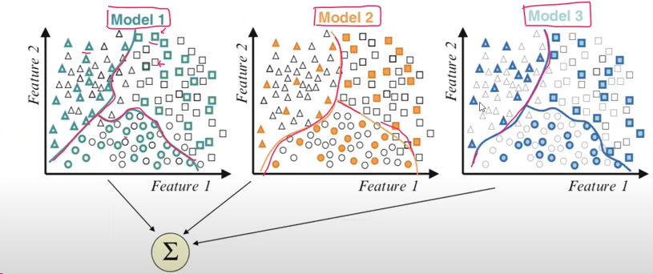
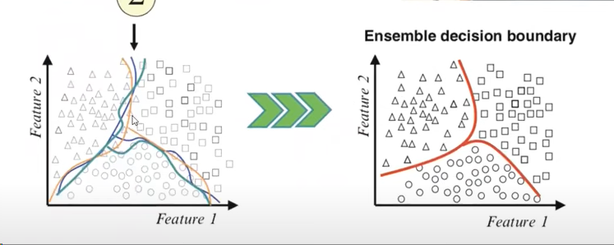
Ensamble
Classification
Class: Square, triangle, circle
The dark one is training
The b/w is testing data

Slide 14
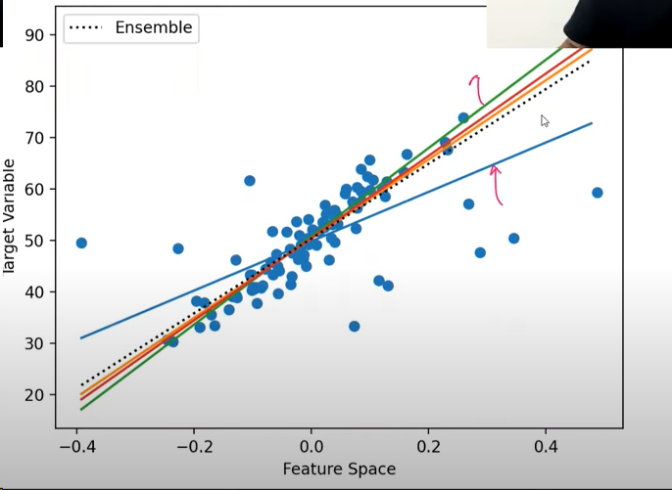
Regression

Slide 15
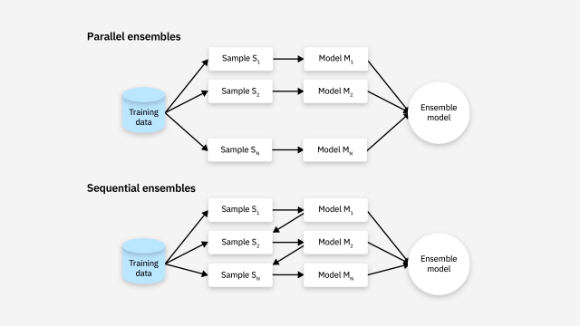
Literature widely categorizes ensemble learning methods in machine learning into two groups: parallel and sequential.
Parallel methods train each base learner apart from the others of the others. Per its name, then, parallel ensembles train base learners in parallel and independent of one another.
- Sequential methods train a new base learner so that it minimizes errors made by the previous model trained in the preceding step. In other words, sequential methods construct base models sequentially in stages.⁹

Slide 16
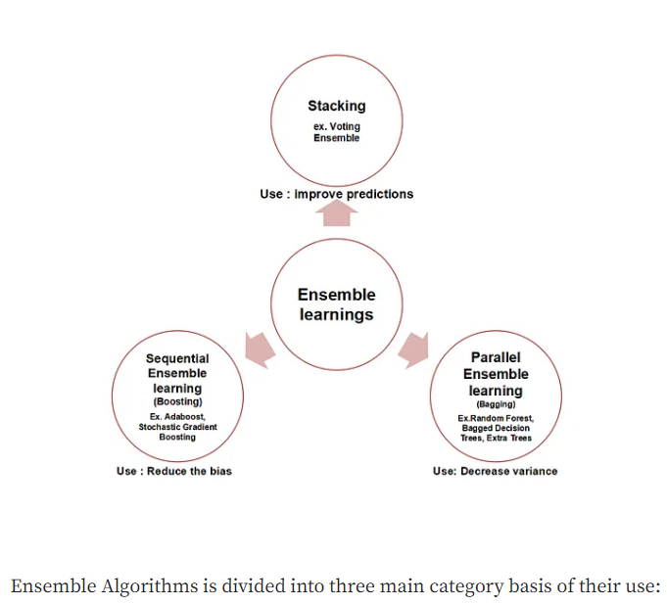
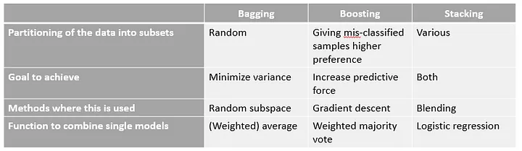
Ensemble learning Types

Slide 17
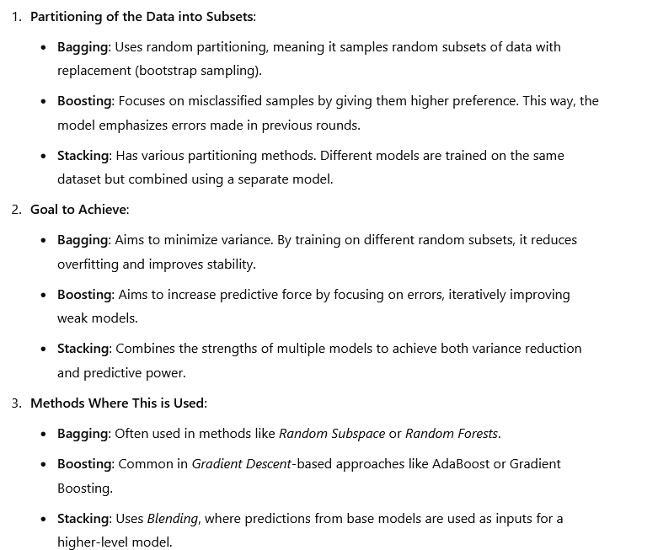

Slide 18
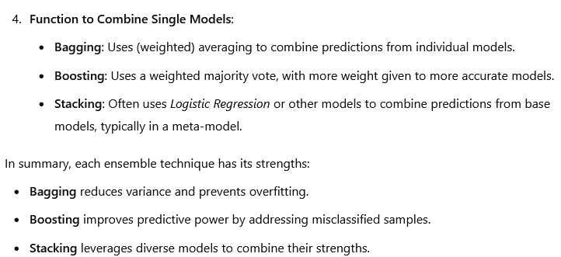

Slide 19
Voting
A Voting Classifier is a machine learning model that trains on an ensemble of numerous models and predicts an output (class) based on their highest probability of chosen class as the output. It simply aggregates the findings of each classifier passed into Voting Classifier and predicts the output class based on the highest majority of voting. The idea is instead of creating separate dedicated models and finding the accuracy for each them, we create a single model which trains by these models and predicts output based on their combined majority of voting for each output class
Voting Classifier supports two types of votings.
Hard Voting: In hard voting, the predicted output class is a class with the highest majority of votes i.e the class which had the highest probability of being predicted by each of the classifiers. Suppose three classifiers predicted the output class(A, A, B), so here the majority predicted A as output. Hence A will be the final prediction.
Soft Voting: In soft voting, the output class is the prediction based on the average of probability given to that class. Suppose given some input to three models, the prediction probability for class A = (0.30, 0.47, 0.53) and B = (0.20, 0.32, 0.40). So the average for class A is 0.4333 and B is 0.3067, the winner is clearly class A because it had the highest probability averaged by each classifier.

Slide 20
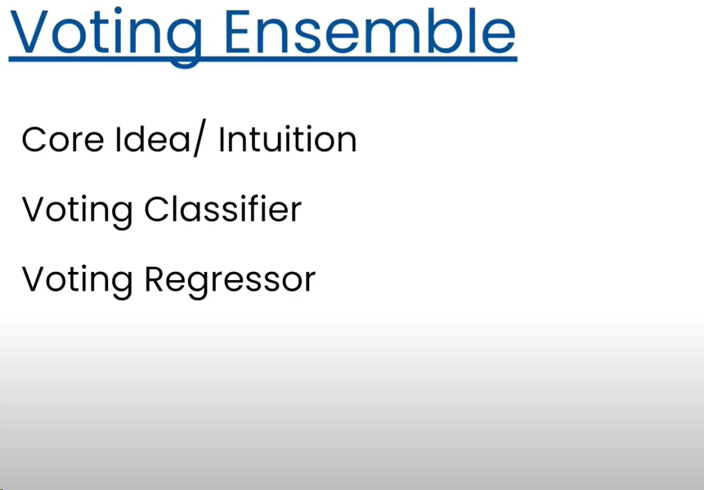
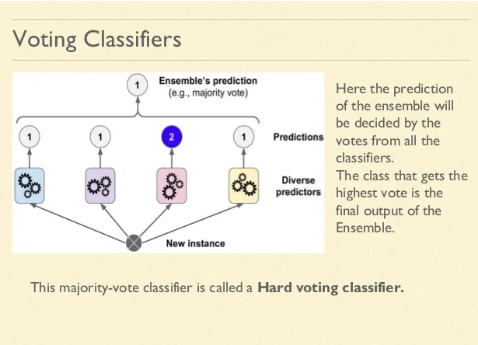

Slide 21
Classifier:
https://medium.com/ml-research-lab/ensemble-learning-the-heart-of-machine-learning-b4f59a5f9777
https://medium.com/@sumbatilinda/ensemble-learning-in-machine-learning-bagging-boosting-and-stacking-a00c6bae971f
https://mohitmishra786687.medium.com/ensemble-learning-a-beginners-guide-c8d6bf283e6d
https://medium.com/geekculture/everything-about-ensemble-learning-46cd96d5498e
https://medium.com/@mygreatlearning/everything-you-need-to-know-about-ensemble-learning-eed79a704a45
https://www.analyticsvidhya.com/blog/2018/06/comprehensive-guide-for-ensemble-models/
https://www.kaggle.com/code/pavansanagapati/ensemble-learning-techniques-tutorial

Slide 22
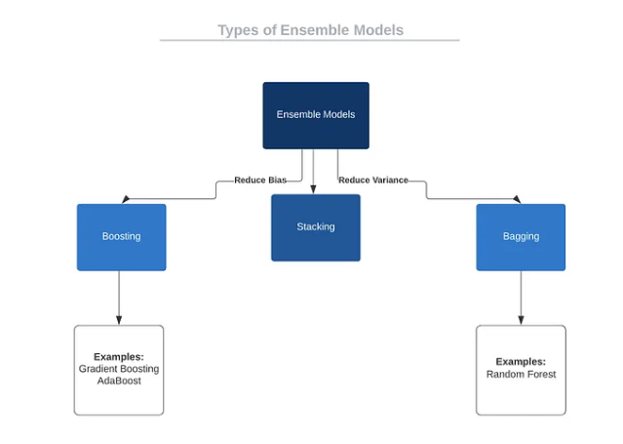
Types of Ensemble Models

Slide 23
Bagging
Bagging, short for bootstrap aggregating, is a type of ensemble learning that involves training multiple models on different subsets of the training data.
The idea behind bagging is to reduce the variance of individual models by training them on different subsets of the data.
The idea behind bagging is combining the results of multiple models (for instance, all decision trees) to get a generalized result. Here’s a question: If you create all the models on the same set of data and combine it, will it be useful? There is a high chance that these models will give the same result since they are getting the same input. So how can we solve this problem? One of the techniques is bootstrapping.
Bootstrapping is a sampling technique in which we create subsets of observations from the original dataset, with replacement. The size of the subsets is the same as the size of the original set.
The Bagging (or Bootstrap Aggregating) technique uses these subsets (bags) to provide a fair idea of the distribution (complete set). The size of subsets created for bagging may be less than the original set.

Slide 24
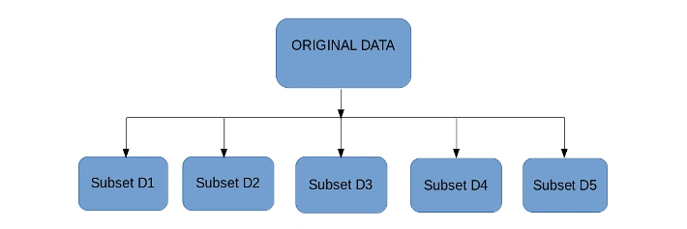
Multiple subsets are created from the original dataset, selecting observations with replacement.
A base model (weak model) is created on each of these subsets.
Generally, all the models used in bagging are of same types
The models run in parallel and are independent of each other.

Slide 25
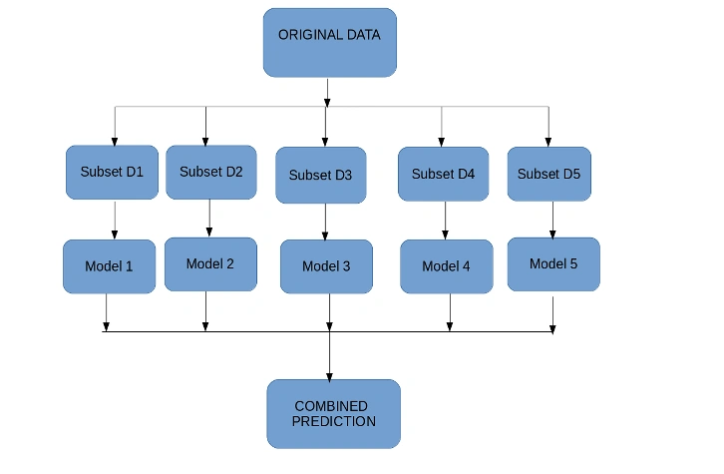
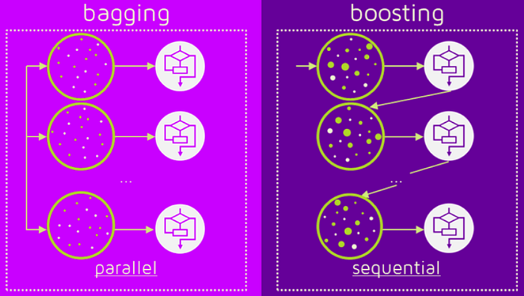
Algorithms : Random Forest, Bagged Decision Trees, Extra Trees

Slide 26
How the results get improved.
In bagging we use those models having low bias high variance. Example decision tree,SVM,KNN.All suffer from overfitting.
In Overfitting when new datapoints come then model will start performing differently
Bu in bagging We are creating subset of data and giving to models(lets say 10 dT) .
Now when new datapoints will come it will get divided between 10 Decision trees so behaviour of model will not change.
So overfitting problem get resolved and already it had low bias that means already it was accurate.

Slide 27
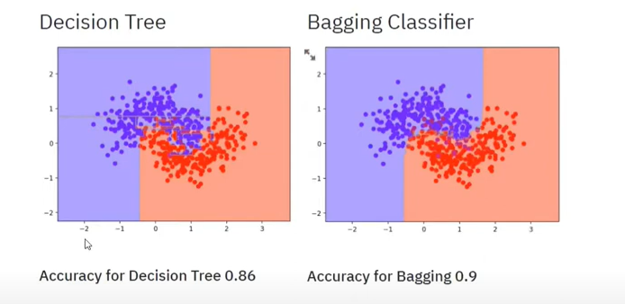
Bagging Classifiers
What happen when we applied bagging

Slide 28
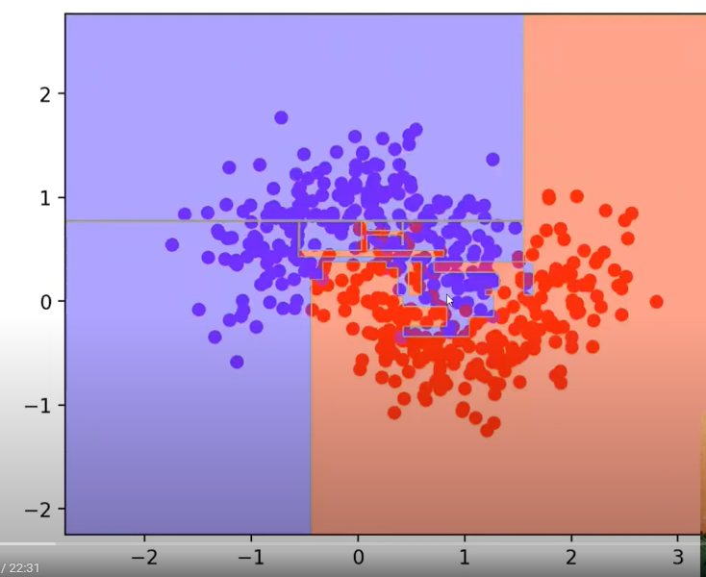
Overfitting occurred in DT

Slide 29
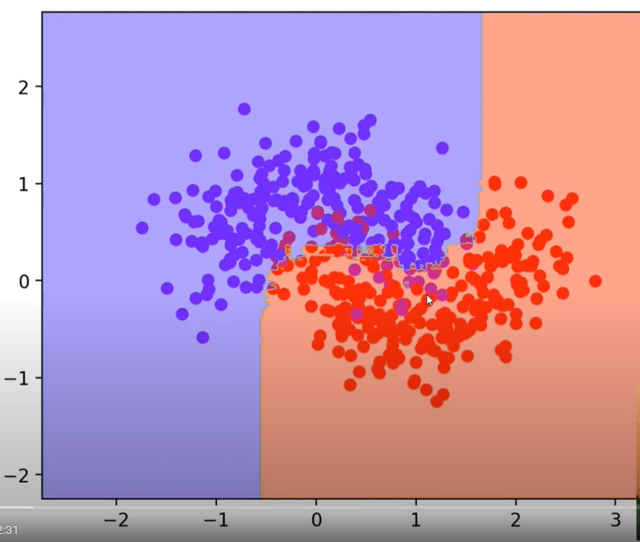

Slide 30
Bagging Regressors
Bagging Regressor creates an ensemble of multiple base regression models and combines their predictions to produce a final prediction. In Bagging Regressor, the base model is typically a regression algorithm, such as Decision Tree Regressor.
How does Bagging Regressor work?
Bootstrap Sampling: The Bagging Regressor generates multiple subsets of the training data by randomly selecting samples with replacements. Each subset is called a bootstrap sample;
Base Model Training: A separate base regression model (e.g., Decision Tree Regressor) is trained on each bootstrap sample. This creates multiple base models, each with its own variation due to the different subsets of data they were trained on;
Aggregation of Predictions: The Bagging Regressor aggregates the predictions from all base models to make predictions. In the case of regression tasks, the predictions are typically averaged across the base models to form the final prediction. This ensemble approach helps to reduce overfitting and improve the overall model performance.

Slide 31
Random Forest
Random forest is a supervised learning algorithm.
The “forest” it builds is an ensemble of decision trees, usually trained with the bagging method.
The general idea of the bagging method is that a combination of learning models increases the overall result.
Put simply: random forest builds multiple decision trees and merges them together to get a more accurate and stable prediction.
It can be applied for both regression and classification problems.
Not too much tuning is required.
Random forest is bagging technique (bagging is bootstrap aggregation),since we are doing sampling randomly so random is coming.
If in bagging we use all base models as DT then it is called Random Forest.

Slide 32
Assumptions of Random Forest
To effectively use Random Forest, it is important to understand the underlying assumptions of the algorithm:
Independence of Trees: The decision trees in the forest should be independent of each other. This is achieved through bootstrap sampling and feature randomness.
Sufficient Data: Random Forest requires a large amount of data to build diverse trees and achieve optimal performance.
Balanced Trees: The algorithm assumes that the individual trees are grown sufficiently deep to capture the underlying patterns in the data.
Noisy Data Handling: Random Forest can handle noisy data, but it assumes that the noise is randomly distributed and not systematic.

Slide 33
Random forest, a popular machine learning algorithm developed by Leo Breiman and Adele Cutler, merges the outputs of numerous decision trees to produce a single outcome.
Its popularity stems from its user-friendliness and versatility, making it suitable for both classification and regression tasks.
Its widespread popularity stems from its user-friendly nature and adaptability, enabling it to tackle both classification and regression problems effectively.
The algorithm’s strength lies in its ability to handle complex datasets and mitigate overfitting, making it a valuable tool for various predictive tasks in machine learning.
One of the most important features of the Random Forest Algorithm is that it can handle the data set containing continuous variables, as in the case of regression, and categorical variables, as in the case of classification.

Slide 34
Random Forest Applications
Customer churn prediction: Businesses can use random forests to predict which customers are likely to churn (cancel their service) so that they can take steps to retain them. For example, a telecom company might use a random forest model to identify customers who are using their phone less frequently or who have a history of late payments.
Fraud detection: Random forests can identify fraudulent transactions in real-time. For instance, a bank might employ a random forest model to spot transactions made from unusual locations or involving unusually large amounts of money.
Stock price prediction: It can predict future stock prices. However, it is important to note that stock price prediction is a very difficult task, and no model is ever going to be perfectly accurate.
Medical diagnosis: These can help doctors diagnose diseases. For example, a doctor might use a random forest model to help them diagnose a patient with cancer.
Image recognition: It can recognize objects in images. For example, a self-driving car might use a random forest model to identify pedestrians and other vehicles on the road.

Slide 35
Real-Life Analogy of Random Forest
A student named X wants to choose a course after his 10+2, and he cant decide which course fit for his skill set. So he decides to consult various people like his cousins, teachers, parents, degree students, and working people. He asks them varied questions like why he should choose, job opportunities with that course, course fee, etc. Finally, after consulting various people about the course he decides to take the course suggested by most people.
Andrew wants to decide where to go during his one-year vacation, so he asks the people who know him best for suggestions. The first friend he seeks out asks him about the likes and dislikes of his past travels. Based on the answers, he will give Andrew some advice.
This is a typical decision tree algorithm approach. Andrew’s friend created rules to guide his decision about what he should recommend, by using Andrew’s answers.
Afterward, Andrew starts asking more and more of his friends to advise him and they again ask him different questions they can use to derive some recommendations from. Finally, Andrew chooses the places that his friends recommend the most to him, which is the typical random forest algorithm approach.

Slide 36
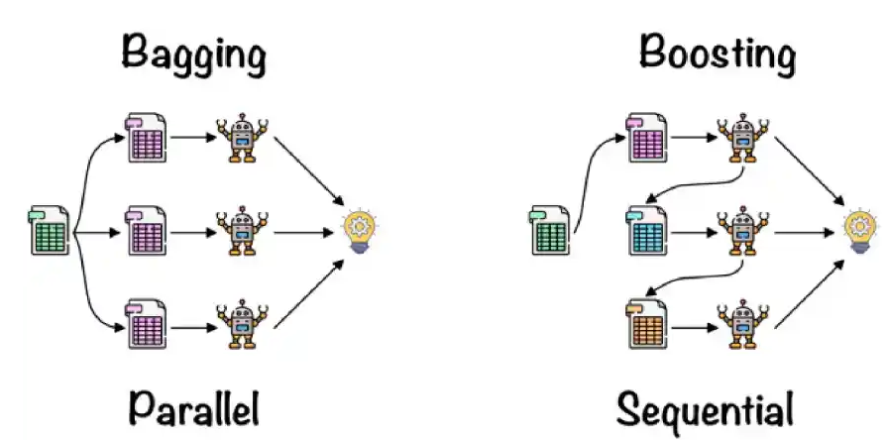
Working of Random Forest Algorithm
Ensemble simply means combining multiple models. Thus a collection of models is used to make predictions rather than an individual model.
Ensemble uses two types of methods:
Random forest Classifier works on the Bagging principle

Slide 37
Bagging, also known as Bootstrap Aggregation, serves as the ensemble technique in the Random Forest algorithm. Here are the steps involved in Bagging:
Selection of Subset: Bagging starts by choosing a random sample, or subset, from the entire dataset.
Bootstrap Sampling: Each model is then created from these samples, called Bootstrap Samples, which are taken from the original data with replacement. This process is known as row sampling.
Bootstrapping: The step of row sampling with replacement is referred to as bootstrapping.
Independent Model Training: Each model is trained independently on its corresponding Bootstrap Sample. This training process generates results for each model.
Majority Voting: The final output is determined by combining the results of all models through majority voting. The most commonly predicted outcome among the models is selected.
Aggregation: This step, which involves combining all the results and generating the final output based on majority voting, is known as aggregation.

Slide 38
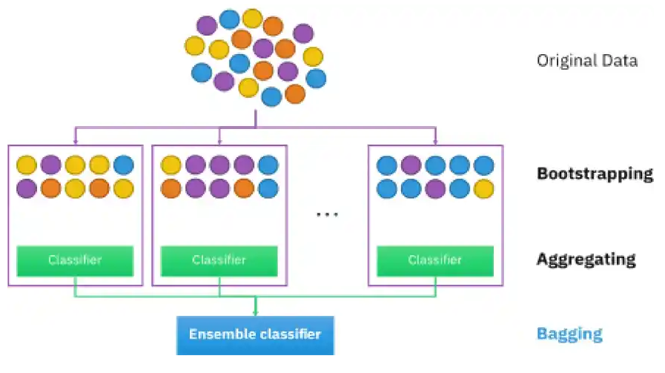

Slide 39
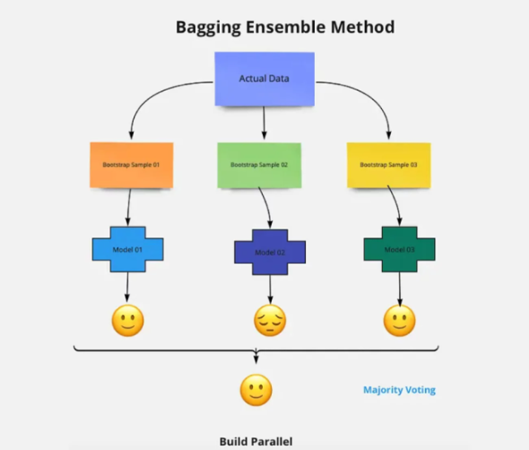
Now let’s look at an example by breaking it down with the help of the following figure.
Here the bootstrap sample is taken from actual data (Bootstrap sample 01, Bootstrap sample 02, and Bootstrap sample 03) with a replacement which means there is a high possibility that each sample won’t contain unique data.
The model (Model 01, Model 02, and Model 03) obtained from this bootstrap sample is trained independently.
Each model generates results as shown.
Now the Happy emoji has a majority when compared to the Sad emoji. Thus based on majority voting final output is obtained as Happy emoji.

Slide 40
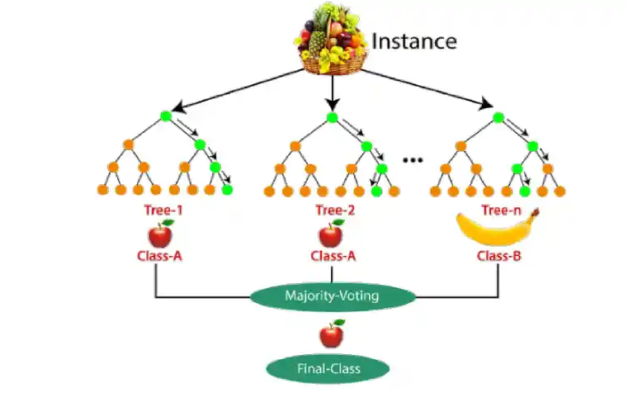
Steps Involved in Random Forest Algorithm
Step 1: In this model, a subset of data points and a subset of features is selected for constructing each decision tree. Simply put, n random records and m features are taken from the data set having k number of records.
Step 2: Individual decision trees are constructed for each sample.
Step 3: Each decision tree will generate an output.
Step 4: Final output is considered based on Majority Voting or Averaging for Classification and regression, respectively.

Slide 41
Important Features of Random Forest
Random Forest is distinguished by several key features that contribute to its effectiveness and versatility:
Diversity: Each decision tree in the Random Forest is built from a different subset of data and features. This diversity helps in reducing overfitting and improving the model’s generalization capability.
Robustness: By averaging the results from multiple trees, Random Forest reduces the variance and improves the robustness of the predictions.
Handling of Missing Values: It can handle missing values internally by using surrogate splits or by averaging results from other trees that do not have missing values for the same data points.
Feature Importance: It provides insights into the importance of each feature in the prediction process. This can be particularly useful for feature selection and understanding the underlying data patterns.
Scalability: Random Forest can be parallelized because each tree is built independently of the others. This makes it scalable to large datasets and high-dimensional data.
Versatility: It can be used for both classification and regression tasks. The algorithm is also effective for tasks involving categorical and continuous variables.
Stability: Due to the ensemble nature, It is less sensitive to changes in the training data compared to a single decision tree.
Out-of-Bag Error Estimation: Random Forest provides an internal mechanism for estimating the model error without the need for a separate validation set. This is done using the out-of-bag (OOB) samples, which are not used in the construction of each tree.

Slide 42
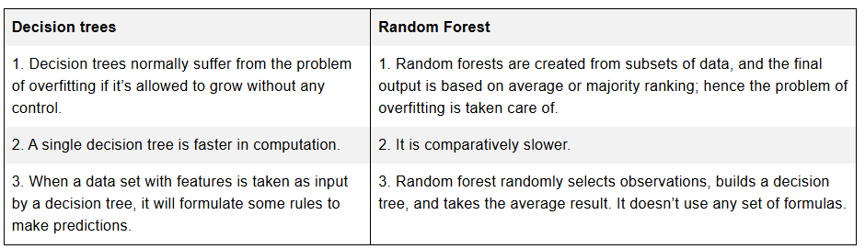
Difference Between Decision Tree and Random Forest

Slide 43
Important Hyperparameters in Random Forest
Increase the Predictive Power
n_estimators: Number of trees the algorithm builds before averaging the predictions.
max_features: Maximum number of features random forest considers splitting a node.
mini_sample_leaf: Determines the minimum number of leaves required to split an internal node.
criterion: How to split the node in each tree? (Entropy/Gini impurity/Log Loss)
max_leaf_nodes: Maximum leaf nodes in each tree
Increase the Speed
n_jobs: it tells the engine how many processors it is allowed to use. If the value is 1, it can use only one processor, but if the value is -1, there is no limit.
random_state: controls randomness of the sample. The model will always produce the same results if it has a definite value of random state and has been given the same hyperparameters and training data.
oob_score: OOB means out of the bag. It is a random forest cross-validation method. In this, one-third of the sample is not used to train the data; instead used to evaluate its performance. These samples are called out-of-bag samples.

Slide 44
Bias ,Variance and Random Forest
Reason for RF to perform good is bias variance trade-off
Bias is when ML model is not giving good result on training data that means its bias is high
Variance is when ML model is giving good result for training data but when a new data is given,it will not perform good
So we want ML model having low Bias and Low variance model
This combination is difficult to find ,we either get LB HV (fully grown DT,KNN,SVM) or HB LV (LR)

Slide 45
Difference between Bagging and Random Forest
1.Bagging can have any model as base model while random forest can have decision tree only as base models
In bagging when we do feature sampling then only selected features will be used in particular DT while in RF at each node again random selection of features will happen
How to apply random forest on a problem(refer to jupiter notebook provided named code example random forest)
End to end project for practice https://www.kaggle.com/code/niklasdonges/end-to-end-project-with-python

